Slide 1
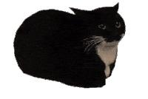

Slide 3
Computational approaches for the therapeutic target discovery to ame-liorate muscle wasting during aging and disease
Msc Karen Guerrero Vazquez
Dr. Katarzyna Whysall
Dr. Pilib O Broin

Slide 4
Update # 3
Diff express genes and Gene Graphs

Slide 5
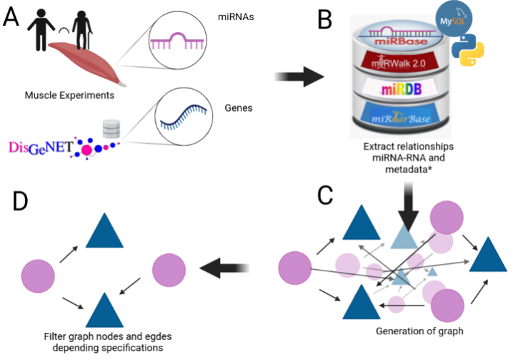
Notes:
We mentioned that aging have a lot of factors attached to it, in the specific case of Sarcopenia we can include chronic inflammation, increased reactive oxidative species, and increased fibrosis of muscle, among others have been reported to contribute to development of sarcopenia

Slide 6
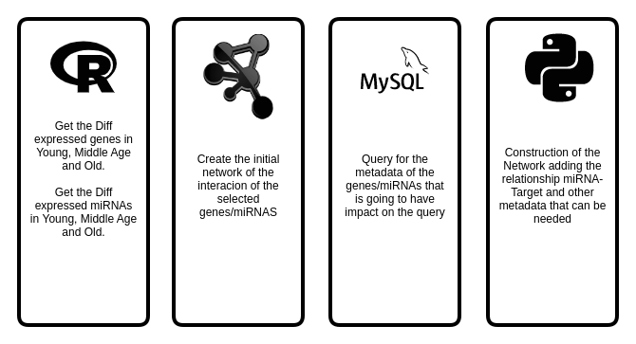
Key points

Slide 7

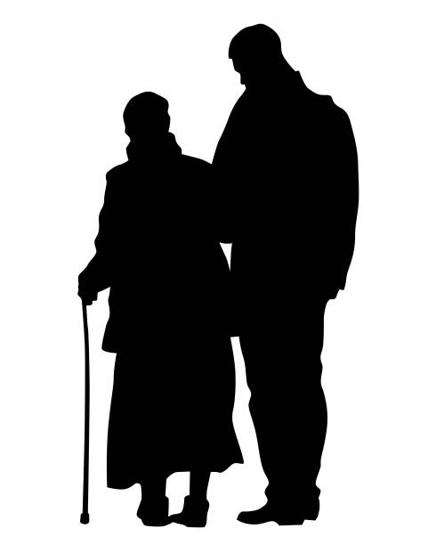

Expression during age
Middle age
Old
Young
<35>
<65>
Y
MA
O

Slide 8
My Experiments
Target | Type | N. Experiments
mRNA | RNASeq | 3
 | MicroArray | 4
miRNA | MicroArray | 1
 | miRSeq | 2
Proteomics | - | 1

Slide 9
Experiment | Evaluation | Regulation | Genes
GSE152558 | MO | Down | 9
GSE152558 | MO | UP | 8
GSE157585 | YO | Down | 73
GSE157585 | YO | UP | 9
GSE164471 | OY | Down | 8
GSE164471 | OY | UP | 5
GSE164471 | MY | Down | 2
GSE164471 | MY | UP | 2
GSE164471 | MO | Down | 11
GSE164471 | MO | UP | 6
GSE875105 | OY | Down | 88
GSE875105 | OY | Up | 18
GSE875105 | MO | Up | 6
GSE23527 | YO | Down | 5
GSE23527 | YO | Up | 1
Notes:
We mentioned that aging have a lot of factors attached to it, in the specific case of Sarcopenia we can include chronic inflammation, increased reactive oxidative species, and increased fibrosis of muscle, among others have been reported to contribute to development of sarcopenia

Slide 10

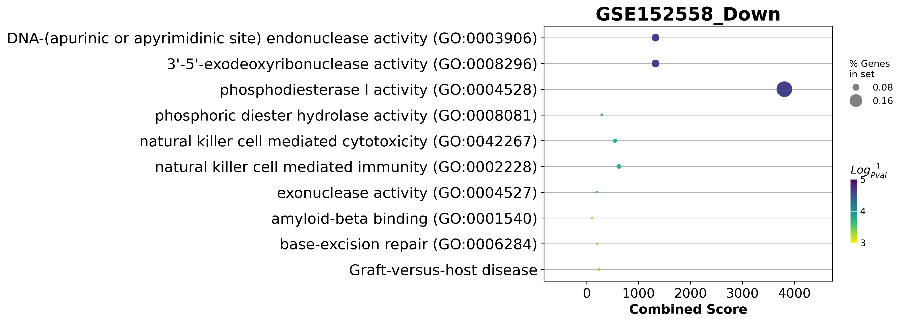
GSE152558 Dotplot

Slide 11
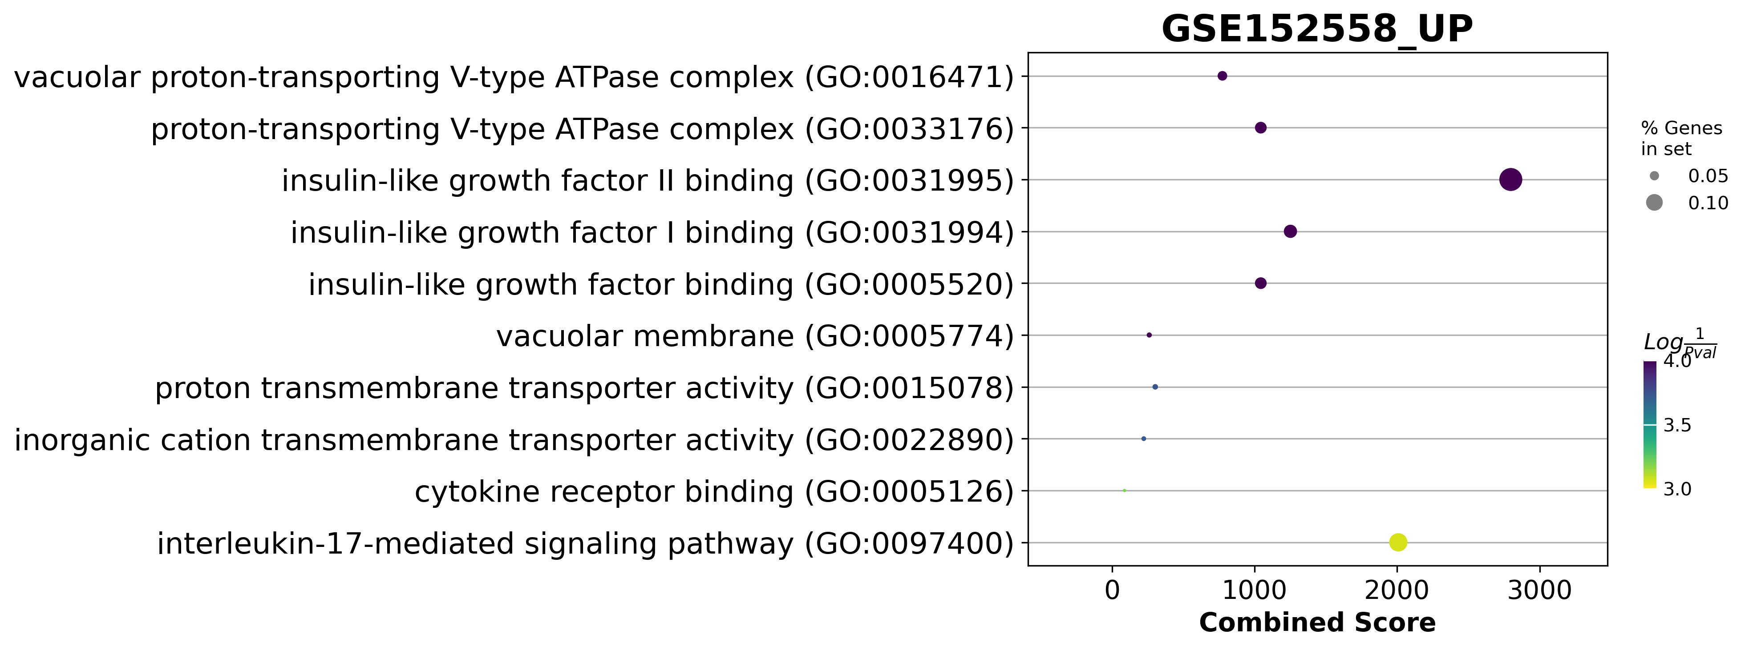
GSE152558 Dotplot

Slide 12
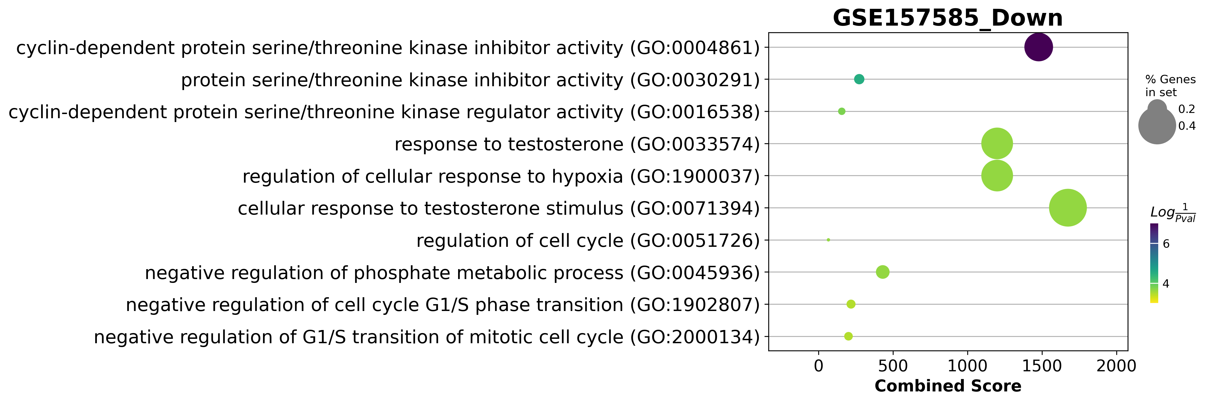
GSE157585 Dotplot

Slide 13
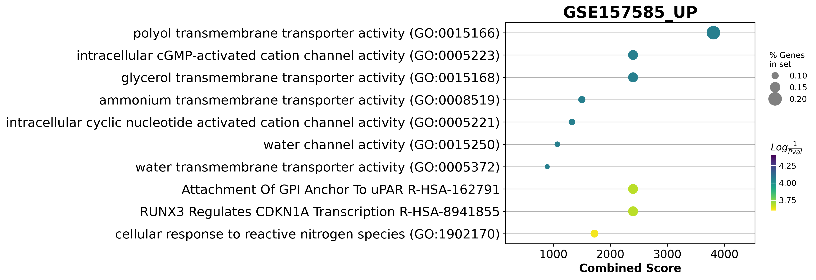
GSE157585 Dotplot

Slide 14
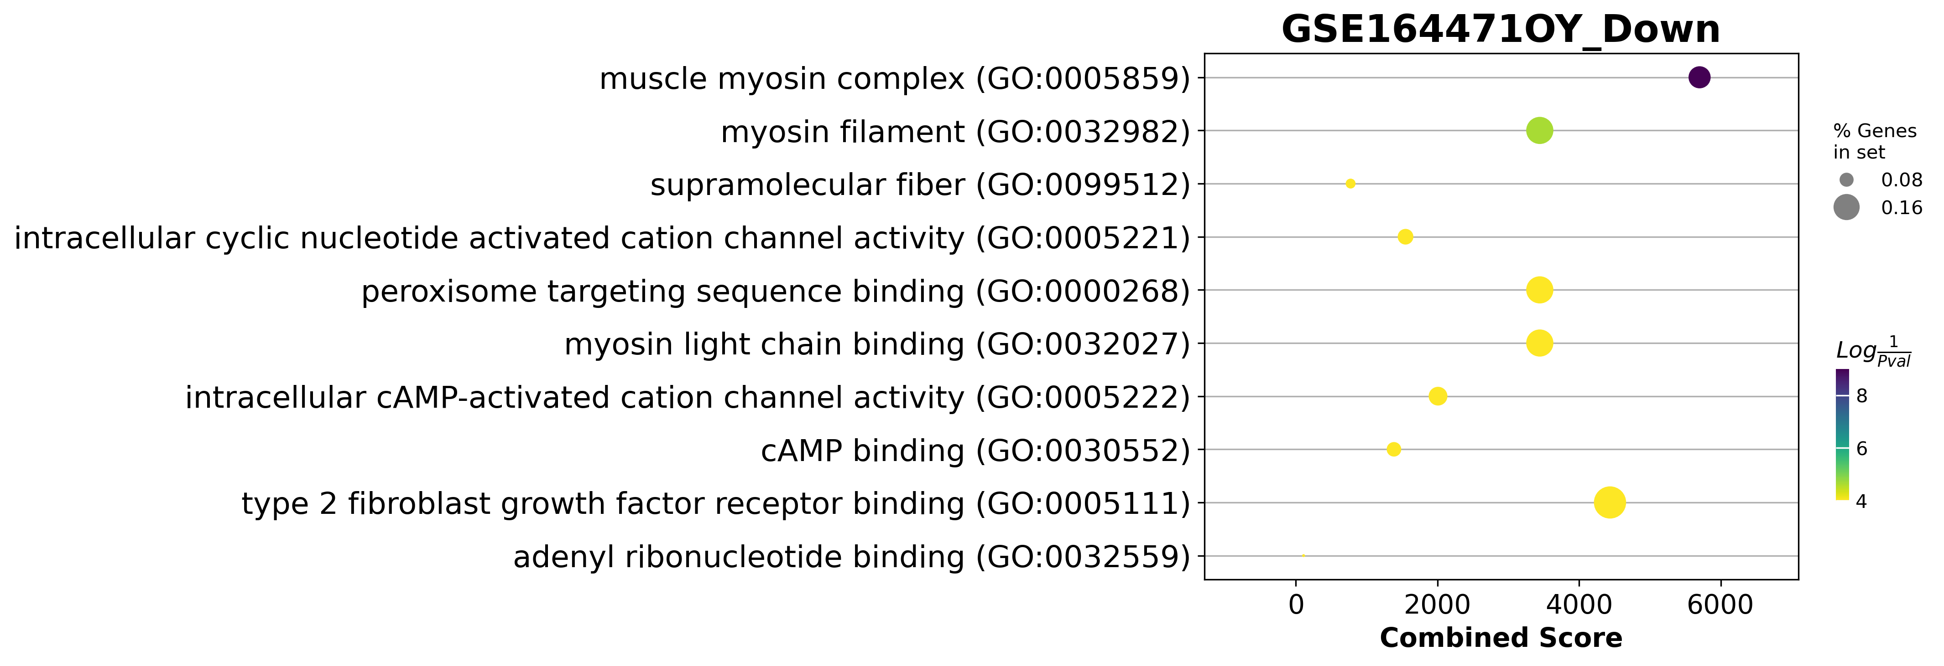
GSE164471 Dotplot

Slide 15
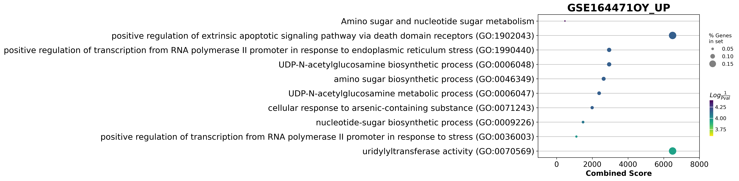
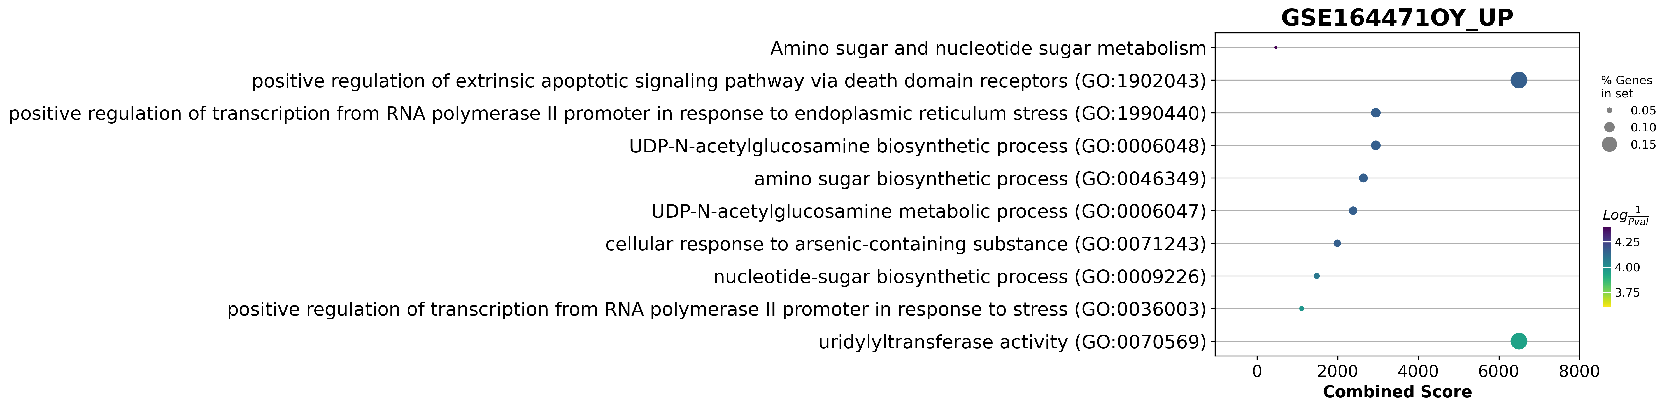
GSE164471 Dotplot
galactose to glucose

Slide 16
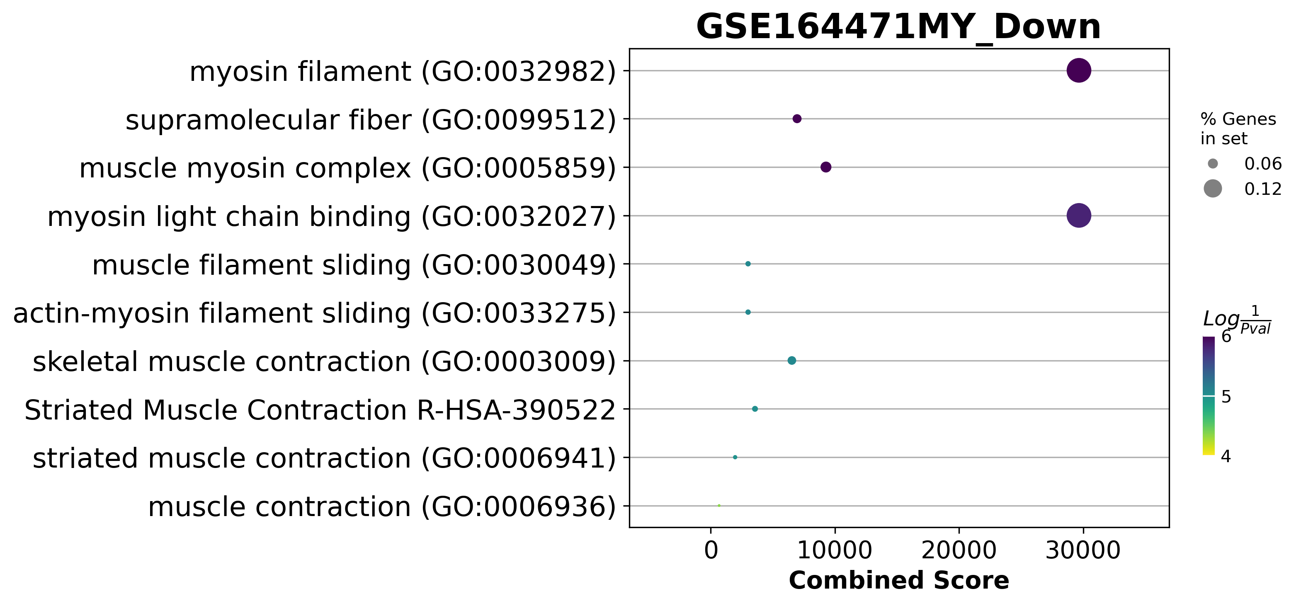
GSE164471Dotplot

Slide 17
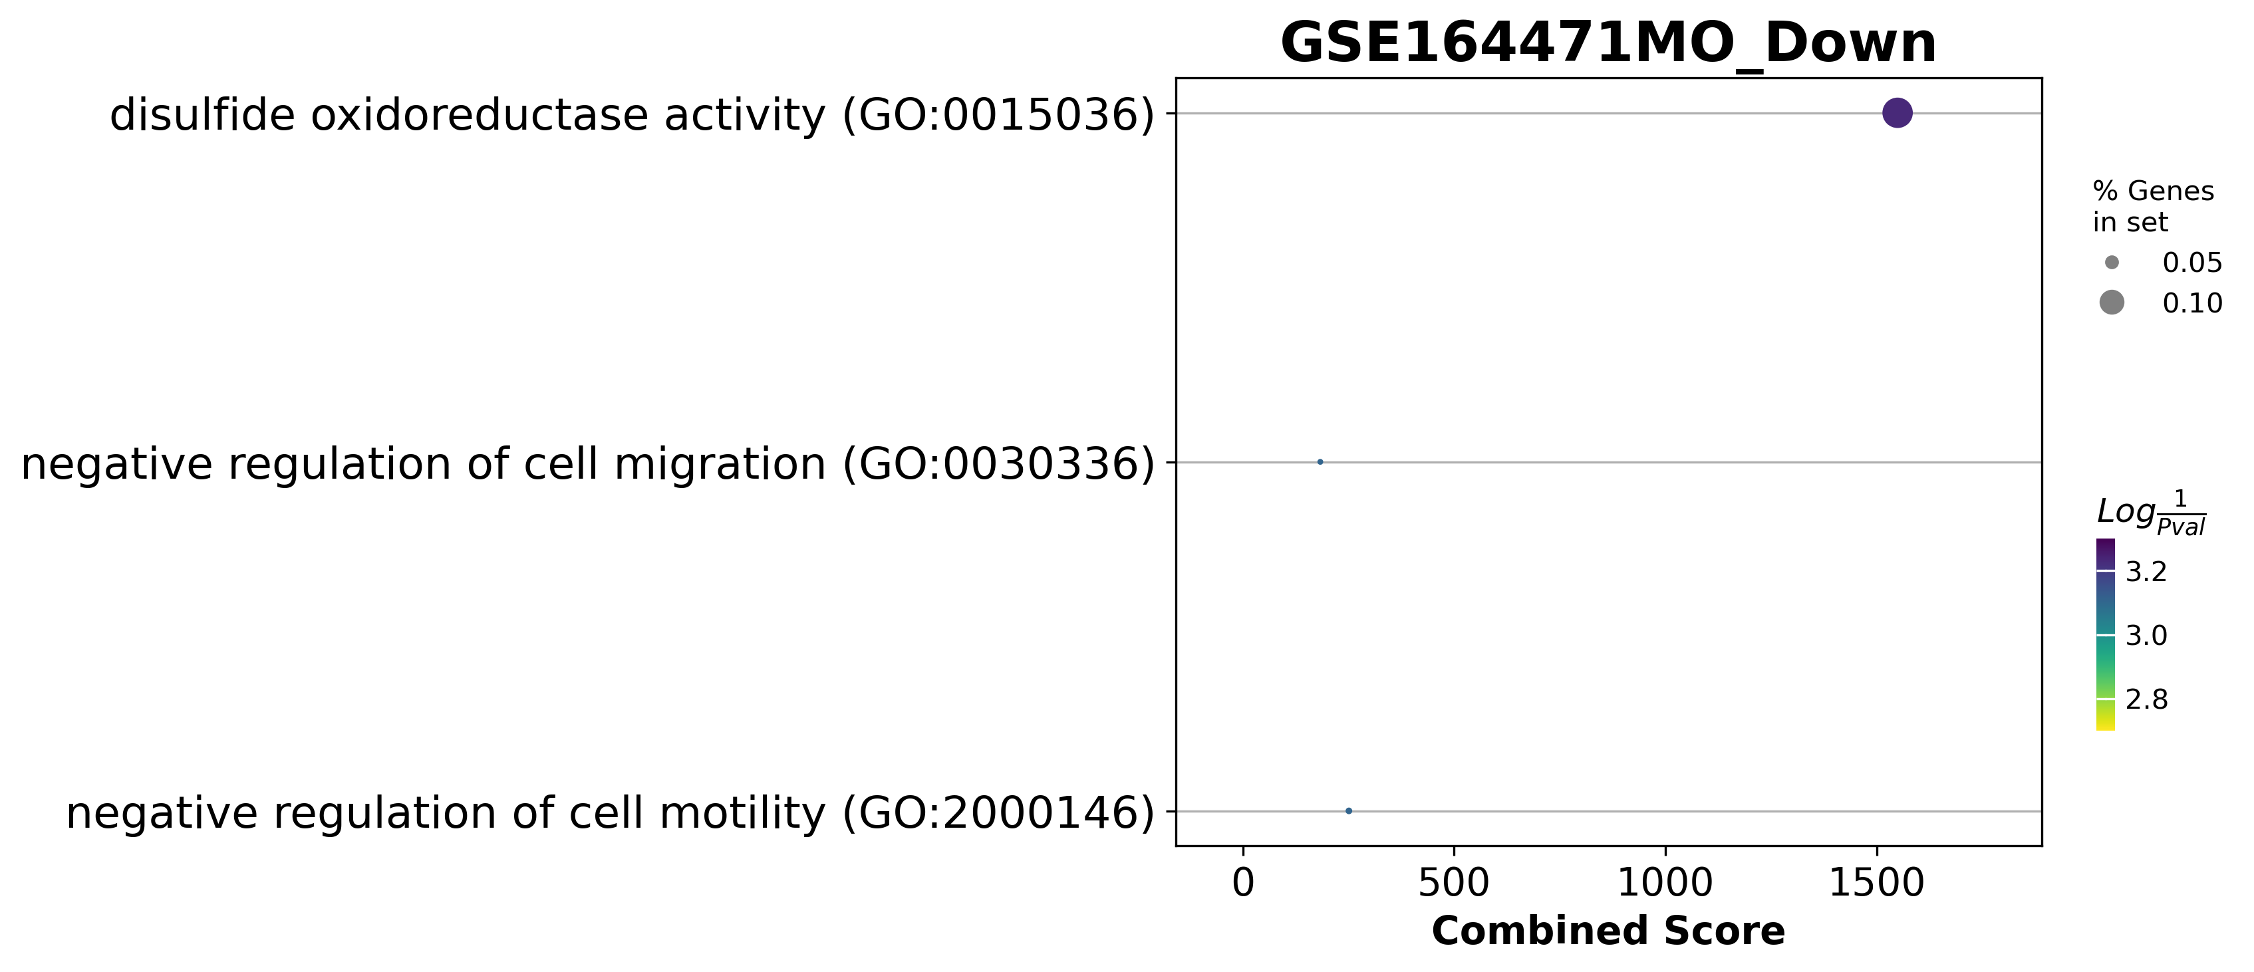
GSE164471Dotplot

Slide 18
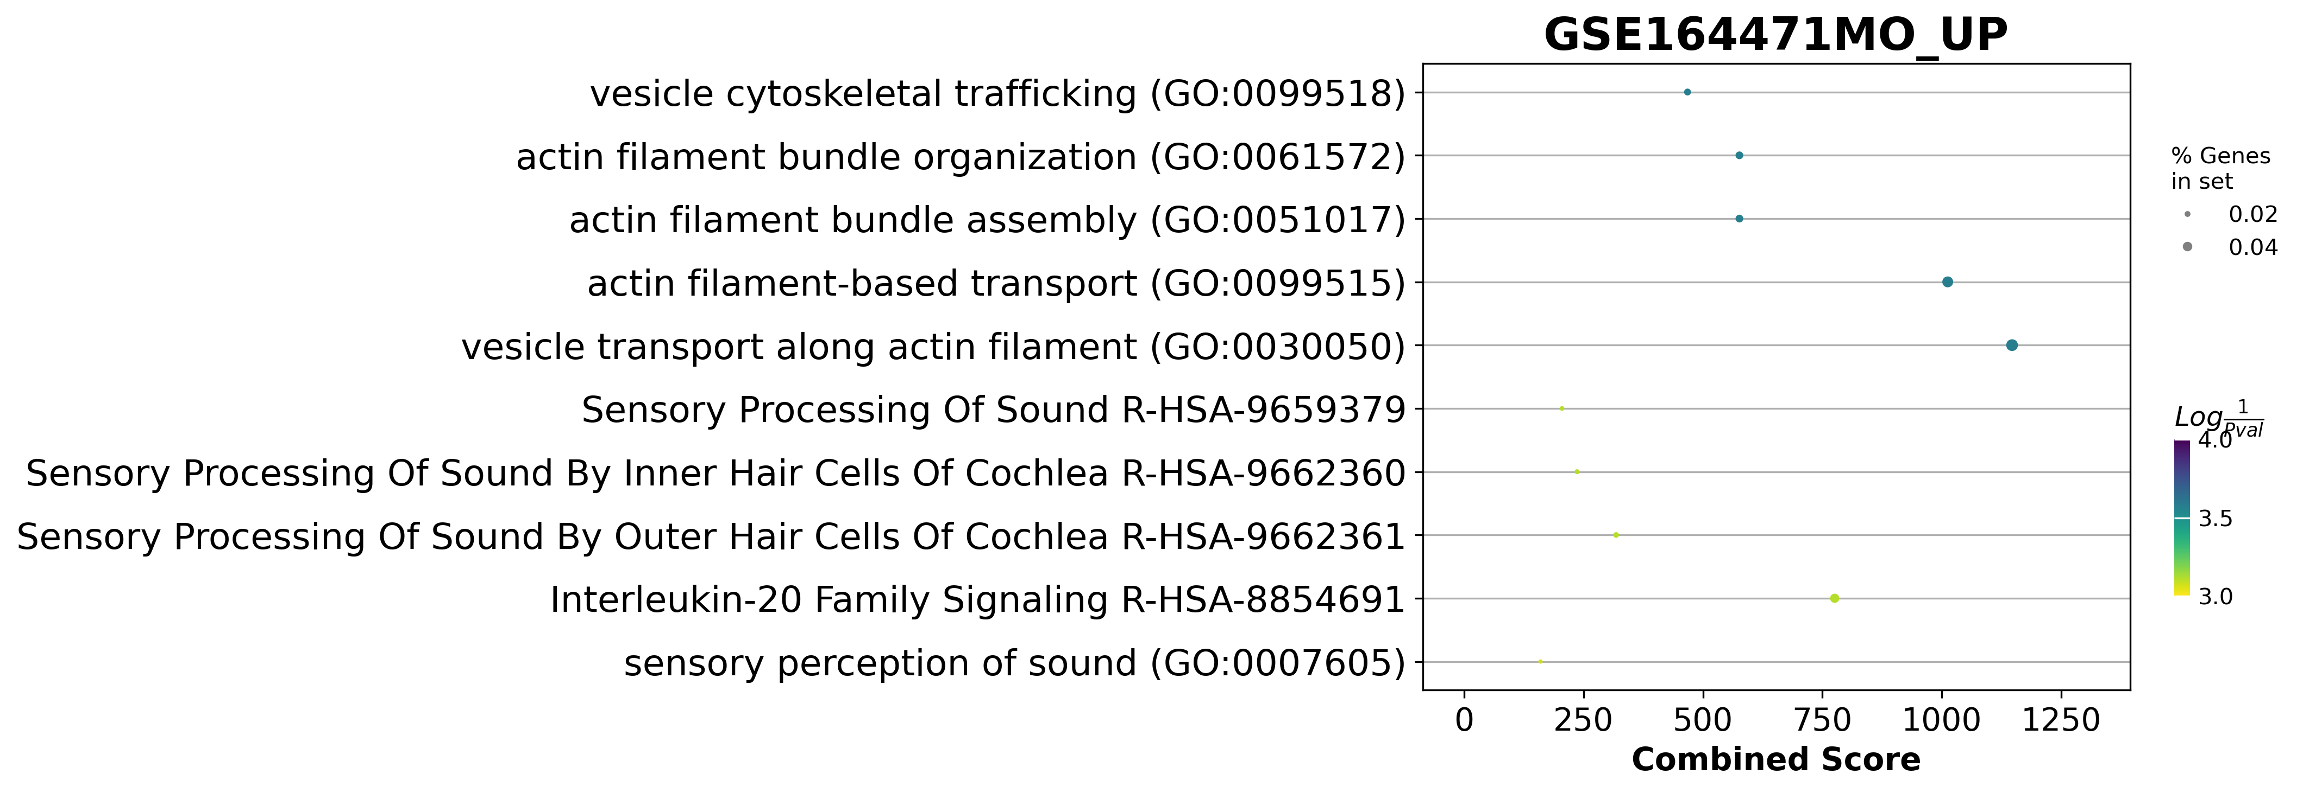
GSE164471Dotplot

Slide 19
GSE164471 was one of the best experiments
Skeletal muscle biopsies were obtained from 53 participants (22–83 years, median = 52 years)
14 Young
21 Middle age
18 Old
if they consumed medication for chronic illness
trained professionally
had a body mass index ≥ 30 kg/m2
were diagnosed with cognitive damage, a physical impairment, or a major disease.

Slide 20
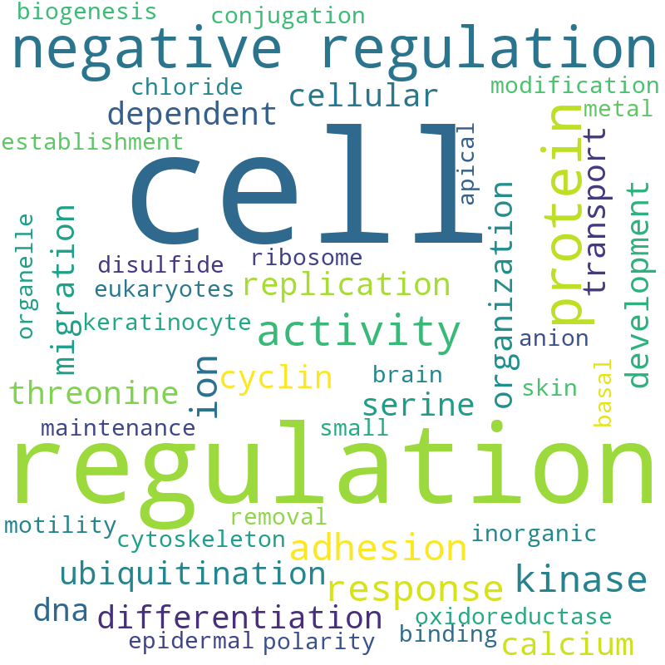
GSE164471(YO) Pathway analysis Word Cloud

Slide 21
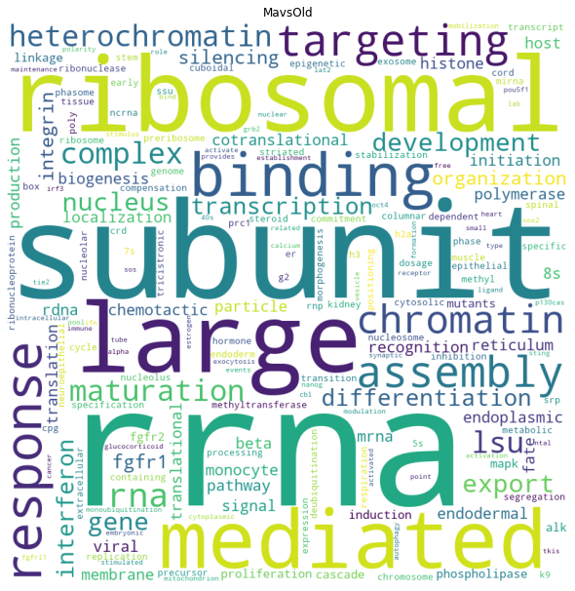
GSE164471(MO) Pathway analysis Word Cloud

Slide 22
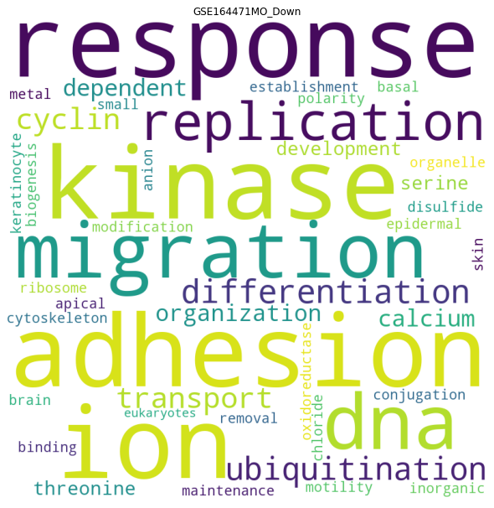
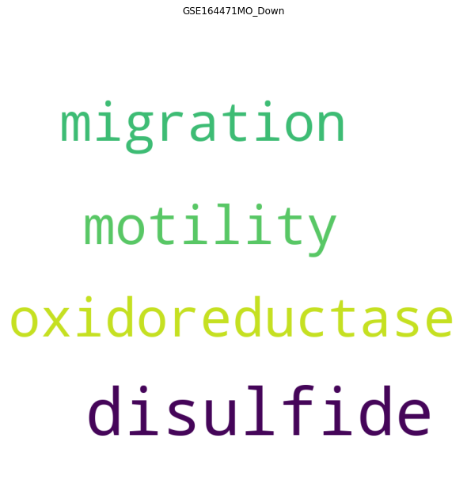
GSE164471(YM) Pathway analysis Word Cloud
Adjust p value < 0.05
Genes pathway coverture > 0

Slide 23
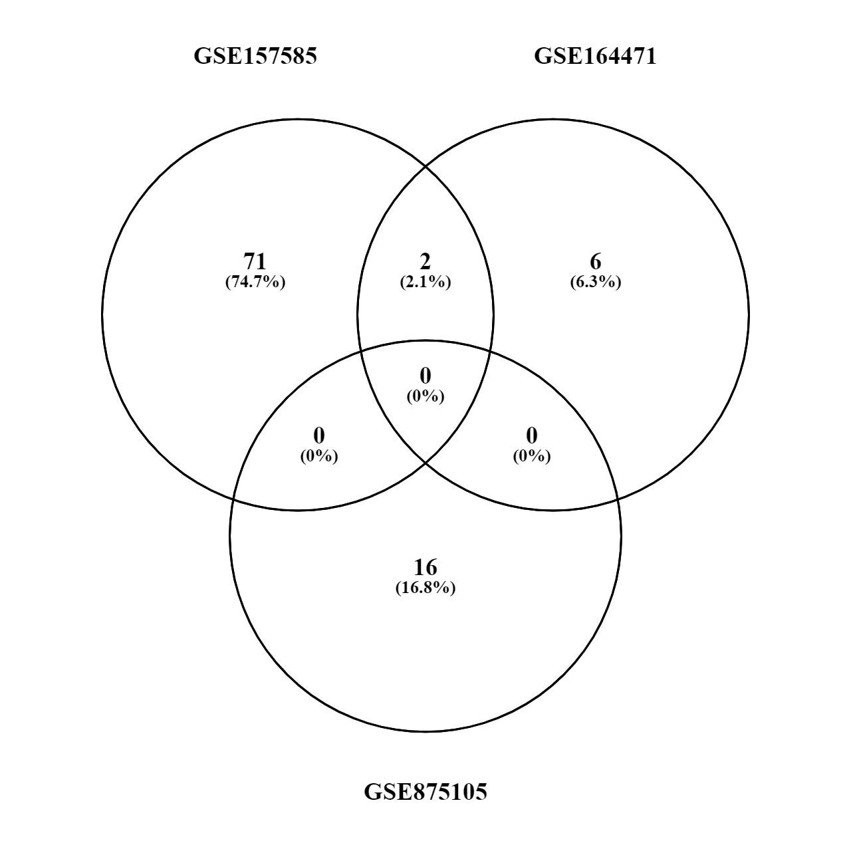
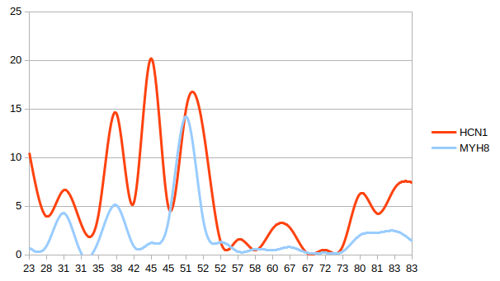
Old vs Young (up or down)
MYH8
HCN1

Slide 24
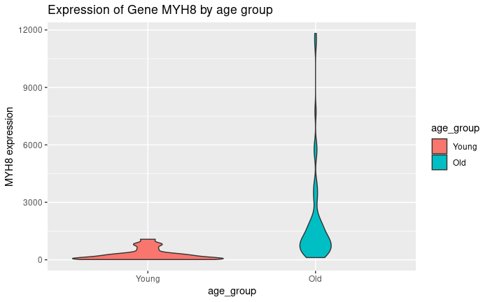
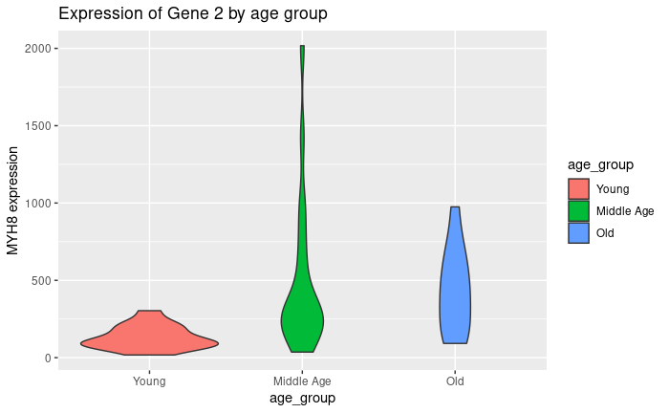
MYH8 raw count over age
GSE157585
GSE164471

Slide 25
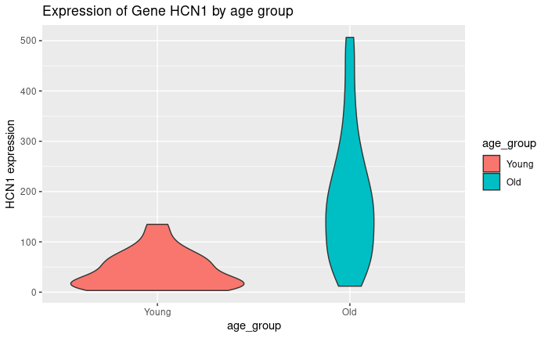
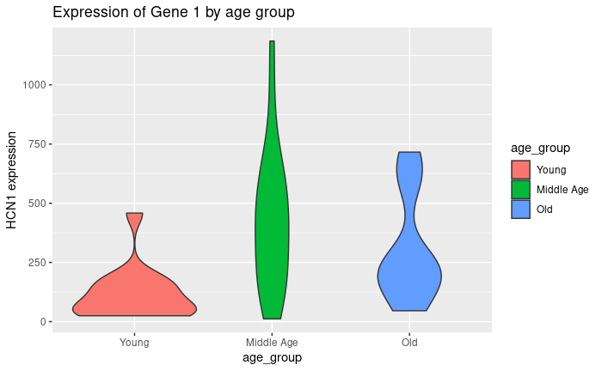
HCN1 raw count over age
GSE157585
GSE164471

Slide 26
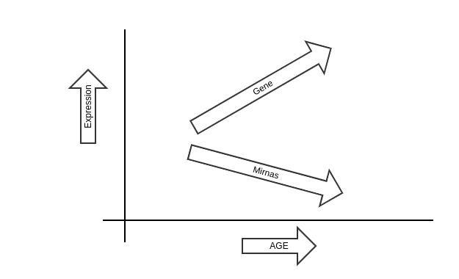
Positive slope

Slide 27
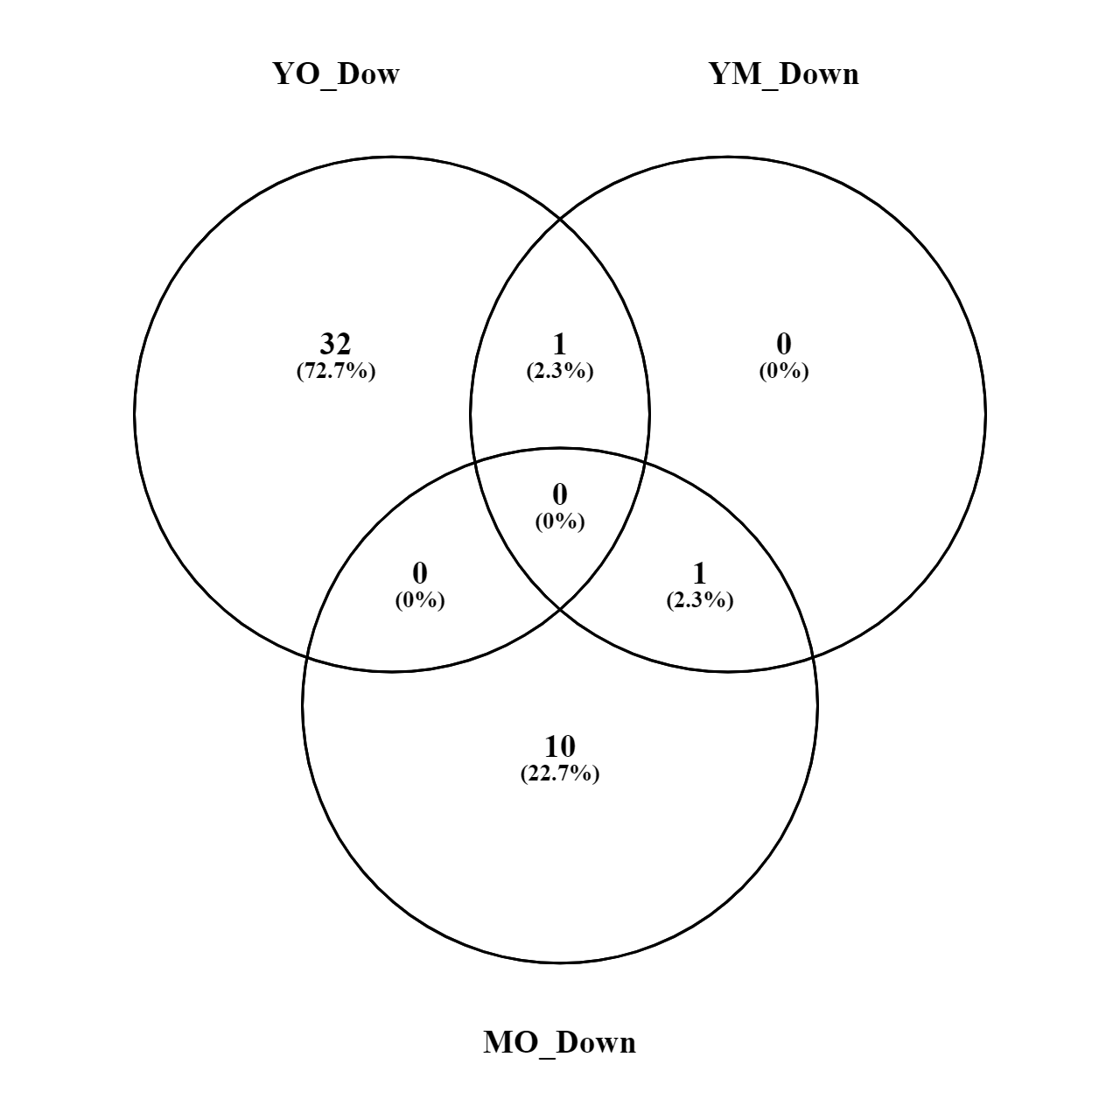
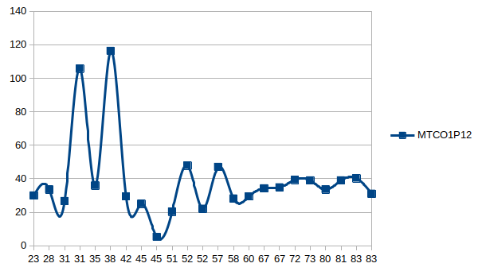
Genes increased by age
MYH8
MTCO1P12

Slide 28

Cytoscape

Slide 29
Young vs Old
YO
VS

Slide 30


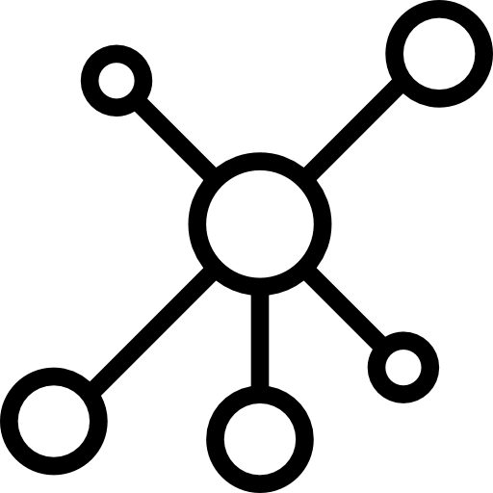
Young vs Old Down-regulated
62 OG
1873 nodes
5958 edges
YO
70 OG
IntAct

Slide 31
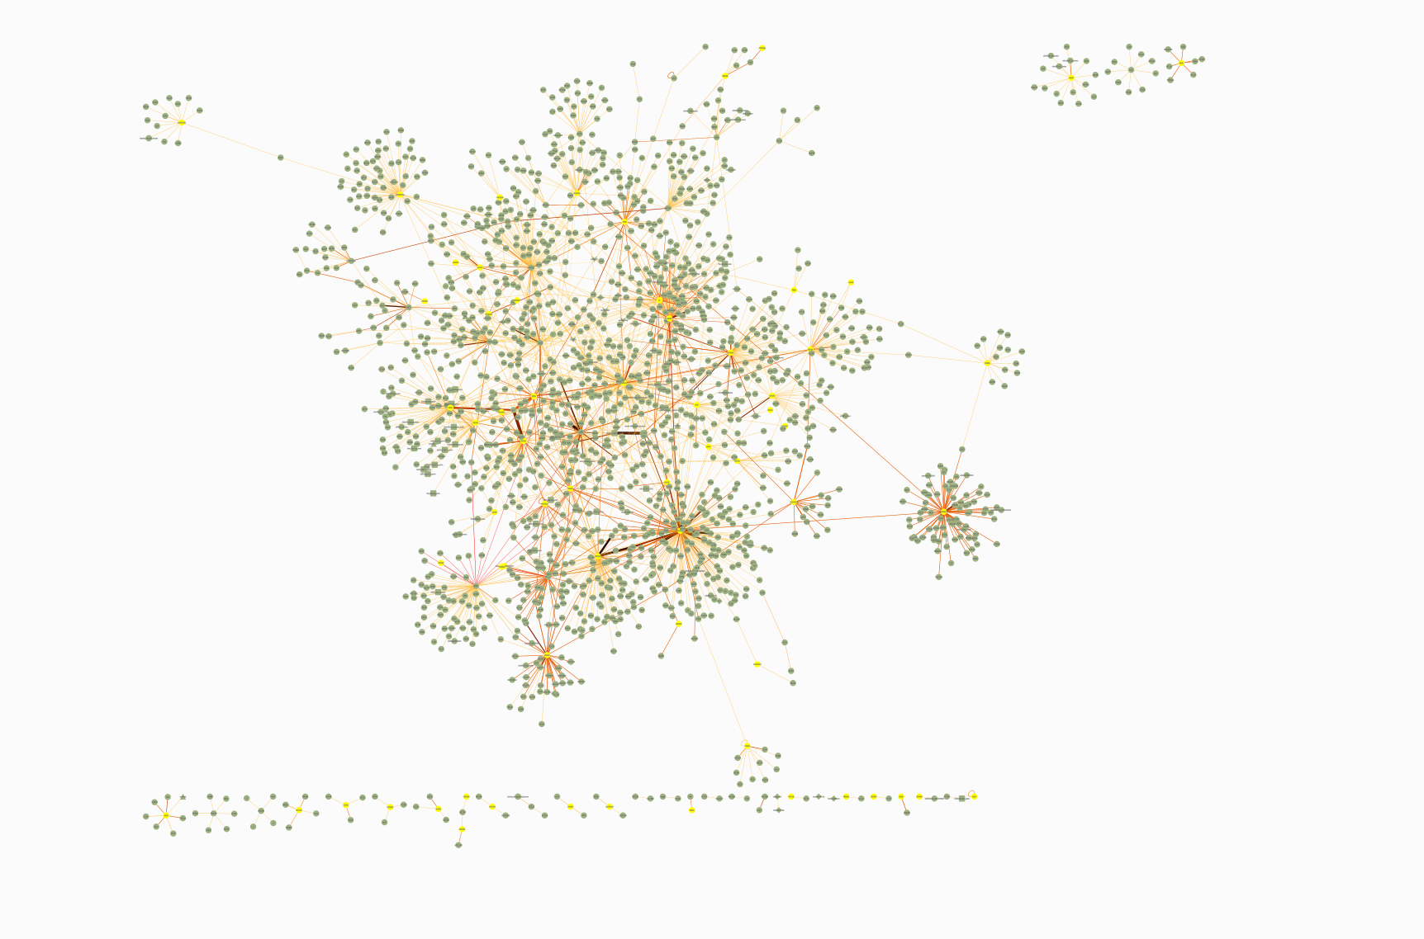
YO

Slide 32

Young vs Old Down-regulated
62 OG
1873 nodes
5958 edges
8 OG
28 miRNAs
109 nodes
287 edges
YO
70 OG
IntAct

Slide 33
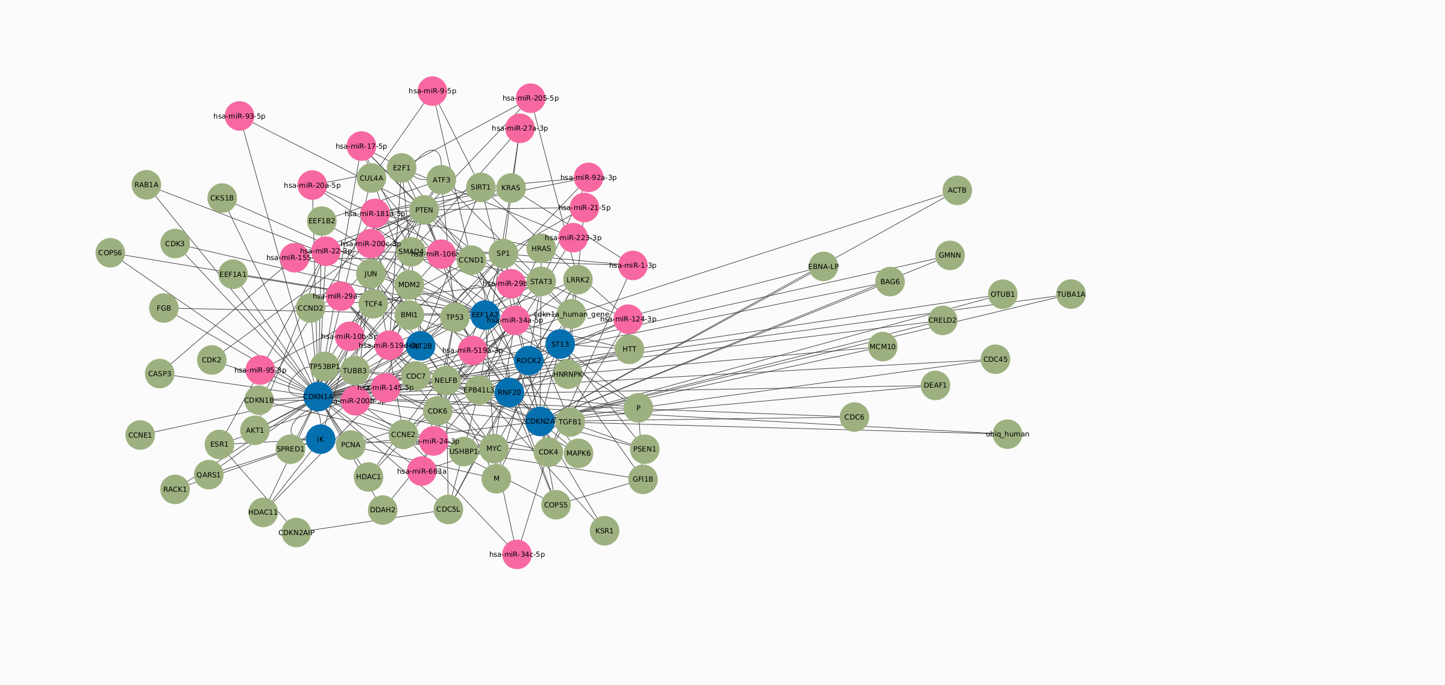
YO

Slide 34
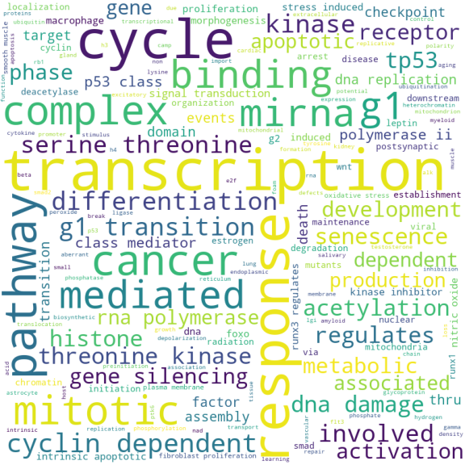
Young vs Old Down-regulated
YO

Slide 35
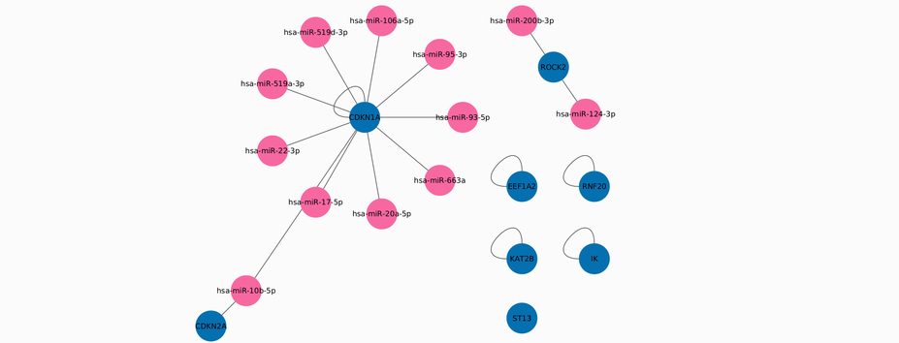
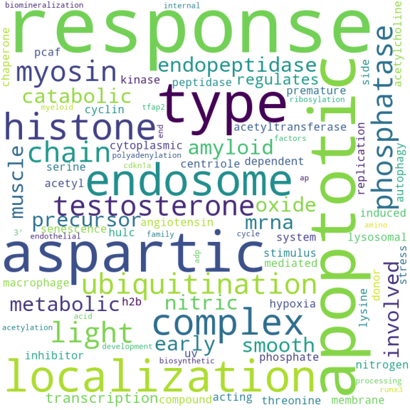
Selecting the OG genes and their connections
YO
8 OG
12 miRNAs
18 edges

Slide 36
Selecting the OG genes and their connections
YO
hsa-miR-519a-3p
hsa-miR-200b-3p
hsa-miR-10b-5p
hsa-miR-95-3p
hsa-miR-124-3p
hsa-miR-17-5p
hsa-miR-106a-5p
hsa-miR-22-3p
hsa-miR-663a
hsa-miR-519d-3p
hsa-miR-93-5p
hsa-miR-20a-5p
CDKN1A
CDKN2A
EEF1A2
IK
KAT2B
RNF20
ROCK2
ST13

Slide 37
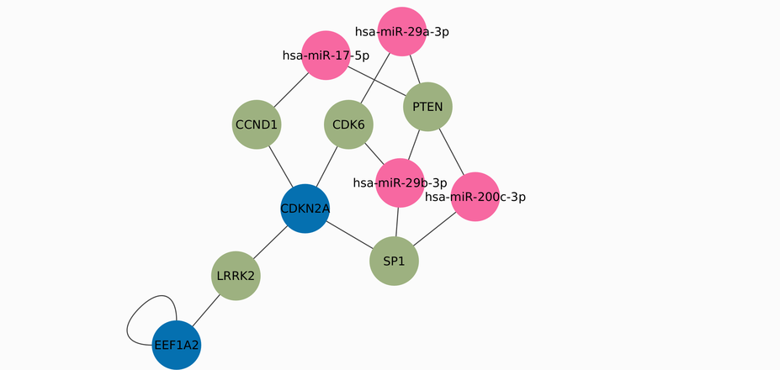
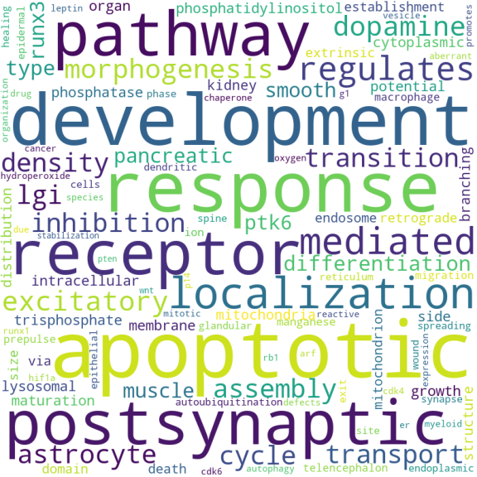
Selecting the higher connected nodes
2 OG
5 interaction genes
4 miRNAs
15 edges
YO

Slide 38
Selecting the higher connected nodes
YO
hsa-miR-200c-3p
hsa-miR-29a-3p
hsa-miR-29b-3p
hsa-miR-17-5p
EEF1A2
CDKN2A
CDK6
SP1
LRRK2
CCND1
PTEN

Slide 39
Young vs Middle Age
YM
VS

Slide 40
Young vs Middle age Down-regulated
1 OG
16 nodes
14 edges
1 OG
3 miRNAs
18 nodes
17 edges
2 OG
IntAct
YM

Slide 41
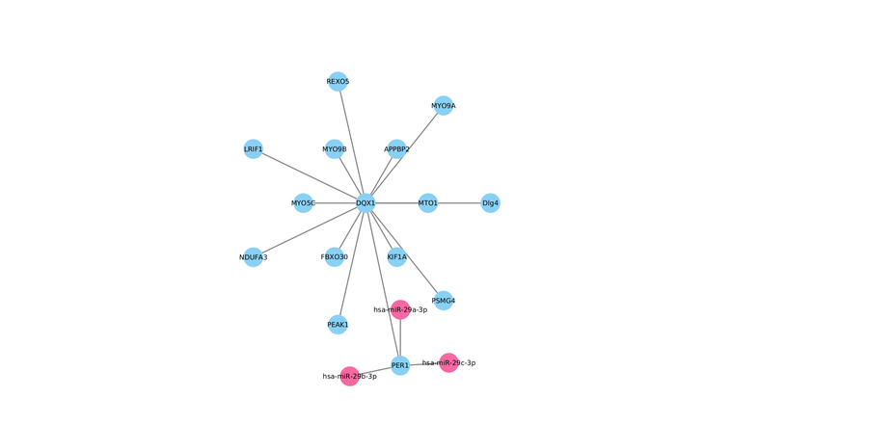
Selecting the higher connected nodes
1 OG
14 interaction genes
3 miRNAs
17 edges
YM
FAIL
hsa-miR-29a-3p
hsa-miR-29b-3p
hsa-miR-29c-3p

Slide 42
Middle Age vs Old
MO
VS

Slide 43
Middle vs Old Down-regulated
7 OG
446 nodes
1292 edges
2 OG
5 miRNAs
151 nodes
163 edges
20 OG
IntAct
MO

Slide 44
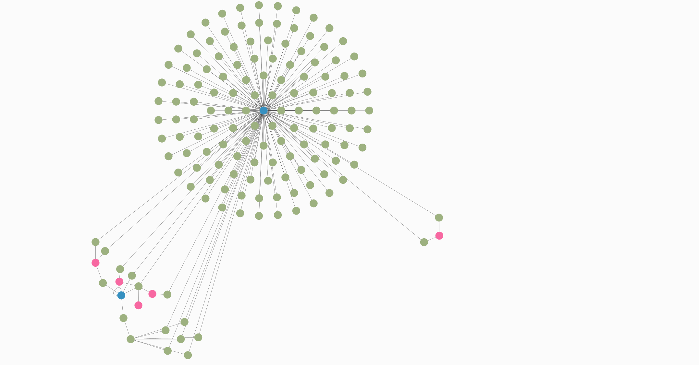
hsa-miR-124-3p
hsa-miR-137
hsa-miR-145-5p
hsa-miR-221-3p
hsa-miR-22-3p
MO

Slide 45
Middle age vs Old Down-regulated
MO

Slide 46
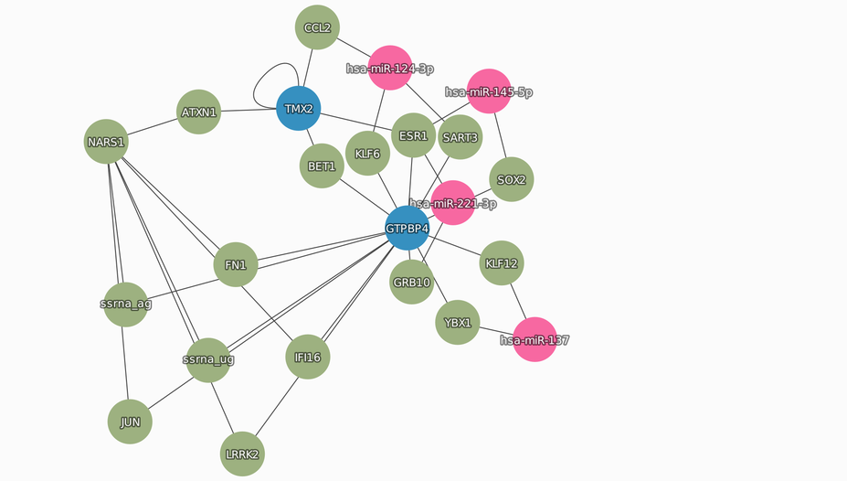
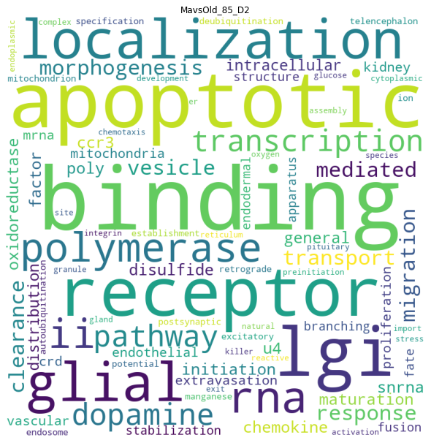
Selecting the OG genes and their connections
2 OG
2 miRNAs
19 interaction genes
35 edges
MO

Slide 47
Selecting the OG genes and their connections
ATXN1
BET1
CCL2
ESR1
FN1
GRB10
IFI16
JUN
KLF12
KLF6
LRRK2
NARS1
SART3
SOX2
YBX1
ssrna_ag
ssrna_ug
hsa-miR-221-3p
hsa-miR-145-5p
hsa-miR-137
hsa-miR-124-3p
GTPBP4
TMX2
MO

Slide 48
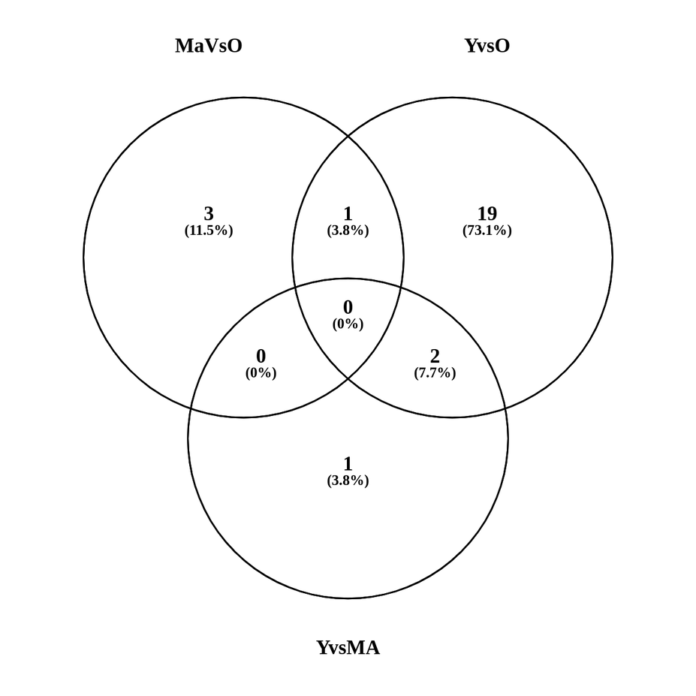
Common miRNAs
Y vsO
M vs O
Y vsO
YO
hsa-miR-29a-3p
hsa-miR-29b-3p
hsa-miR-124-3p
Y vs M
YM
Y vsO
MO
MO
MO
Y vsO
M vs O
Y vs M
Y vs M

Slide 49
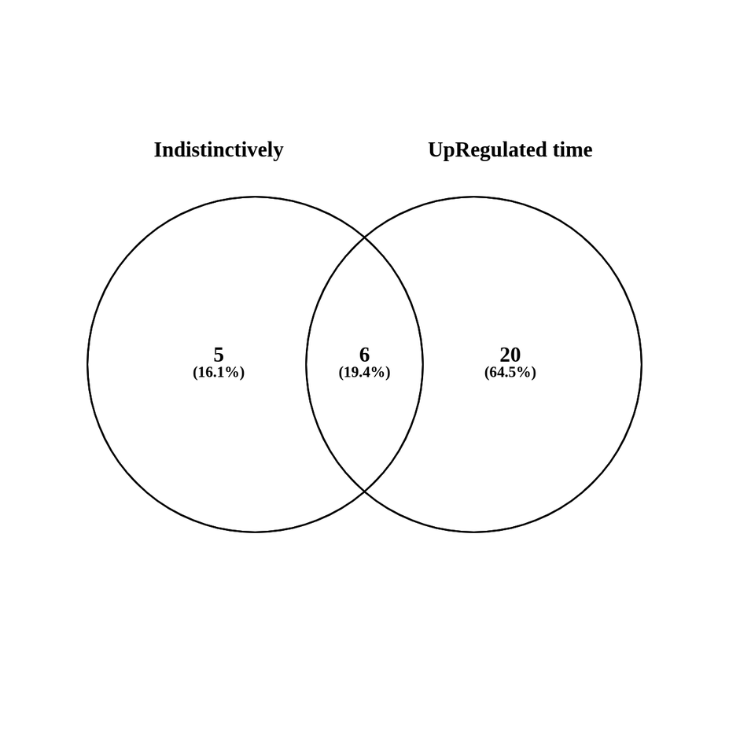
Naive (barbaric) method vs age grouping
YO
hsa-miR-200c-3p
hsa-miR-21-5p
hsa-miR-22-3p
hsa-miR-221-3p
hsa-miR-29a-3p
hsa-miR-29b-3p
YM
MO
MO
MO

Slide 50


What’s going good
The DE genes are defined for all the experiments from miRSeq, RNAseq and microArray from heathy patients.
Scripts are ready for reuse since we have raw and process data
Cytoscape is incorporated and there are plenty of apps to use.
We can get a good view on the OG, miRNAs and other interactive genes
Data like target genes, seeds and other metadata is already on the database, functional and accessible for the public
Integration of cytoscape and MySQL working
Already giving relevant mirnas

Slide 51
What can be improved
Cleaner code
Use apps with more biological information like GeneMania
Add the tissue expression data and include more minra:target databases
Use of more relevant centralities like RankPage en eigenvalue
Include more metadata in the seleccion of the nodes

Slide 52

What’s next
GeneMania
Include parsed data to the database
Improve node selection
Co-expression
Physical interactions
Shared protein domains
Pathways
Genetic interactions
Average expression of mirnas (mirnaTissueAtlas)
Add gene names to the Transcripts for miRDB and mirWalk
Add layer with MirGeneDB
Use different centralities
Apply formula to define weight including the metadata
Write a ShinyApp
Create as app for Cytoscape

Slide 53
Questions?
?

Slide 54
Thank You

Slide 55
Acknowledgements
This presentation has emanated from research conducted with the financial support of Science Foundation Ireland under Grant number [18/CRT/6214 ]

